Slide 1

Coffee shop/ education app
Heather M Cruce
2 Months Duration
Tools:
Figma
Miro
WAVE
Zeplin
Lookback

Slide 2
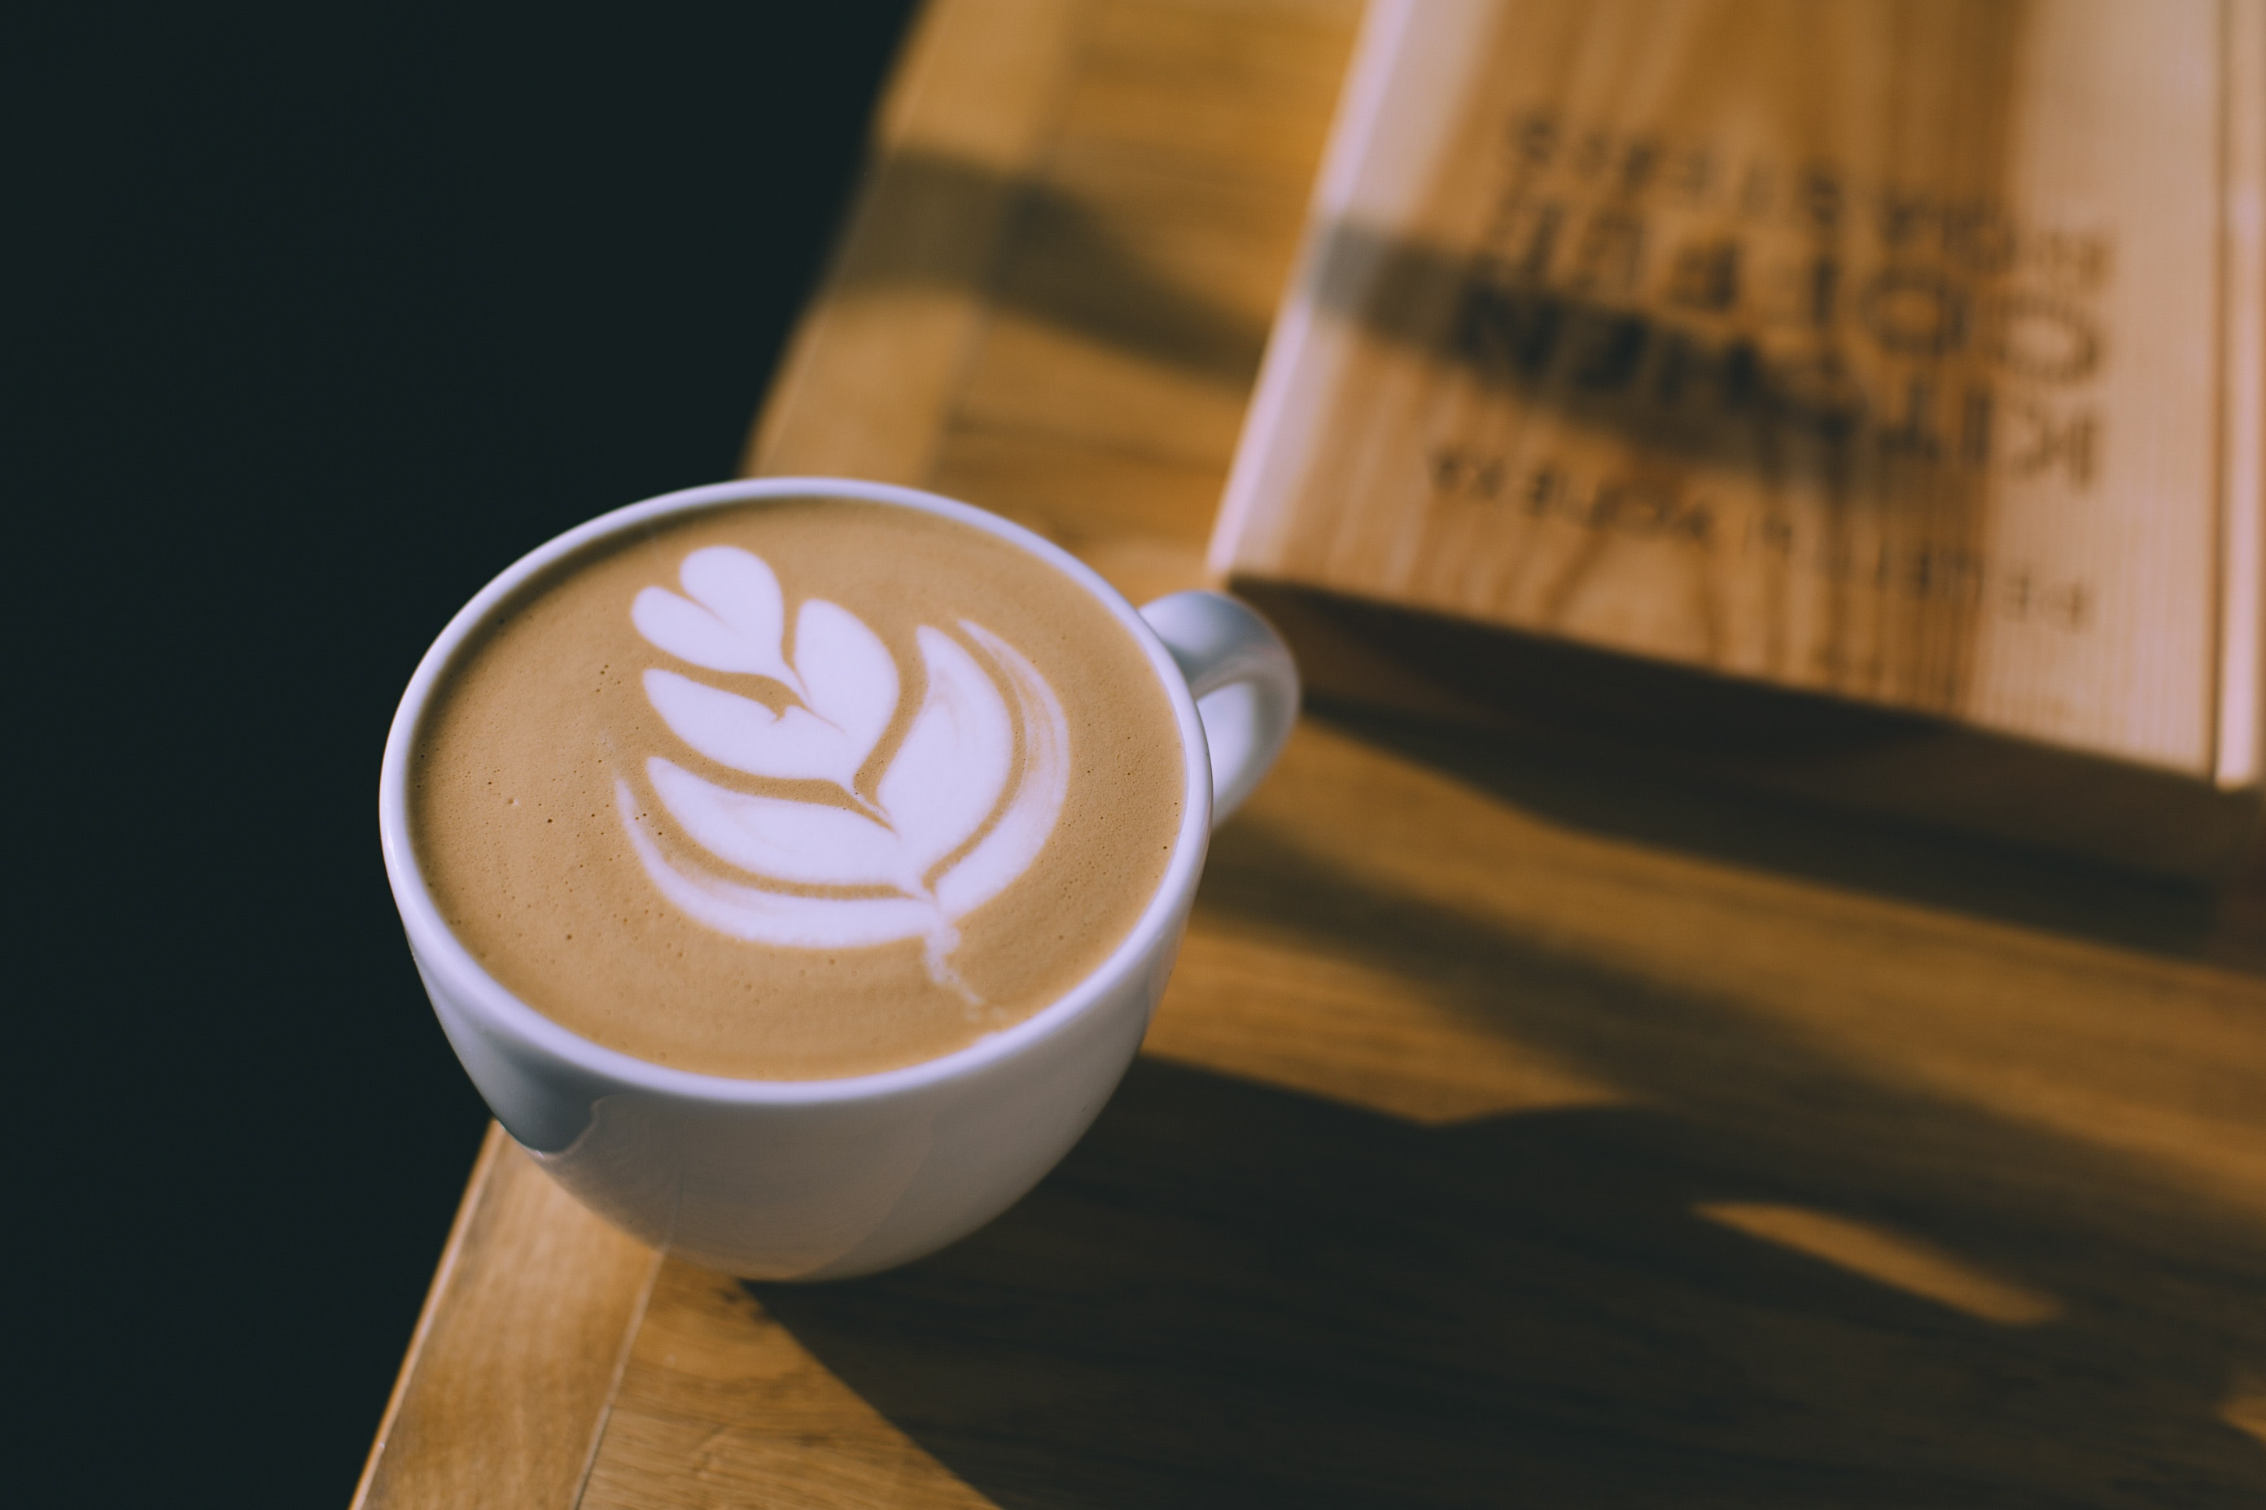


Challenge
The Design Problem:
Udacity is considering opening a digitally-enabled coffee shop
experience. As part of this experience, students will be able to use an app (mobile or web-based), which exists separately from the Udacity classroom, to perform actions such as:
Placing their drink orders
Collaborating with other students in the café
Motivating progress on a Nanodegree
Facilitating a productive study environment

Slide 3
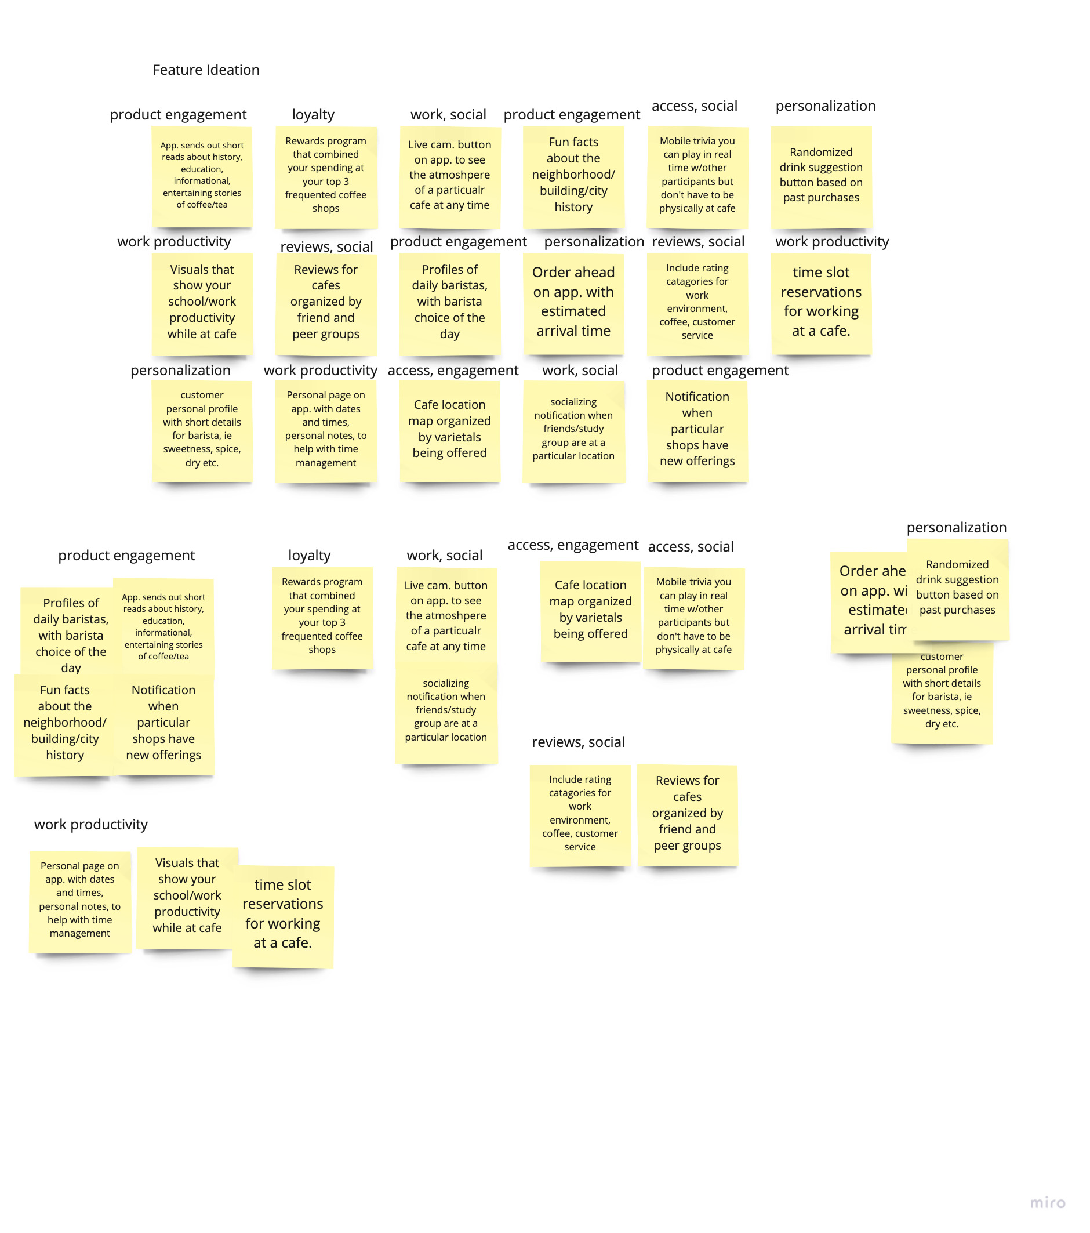
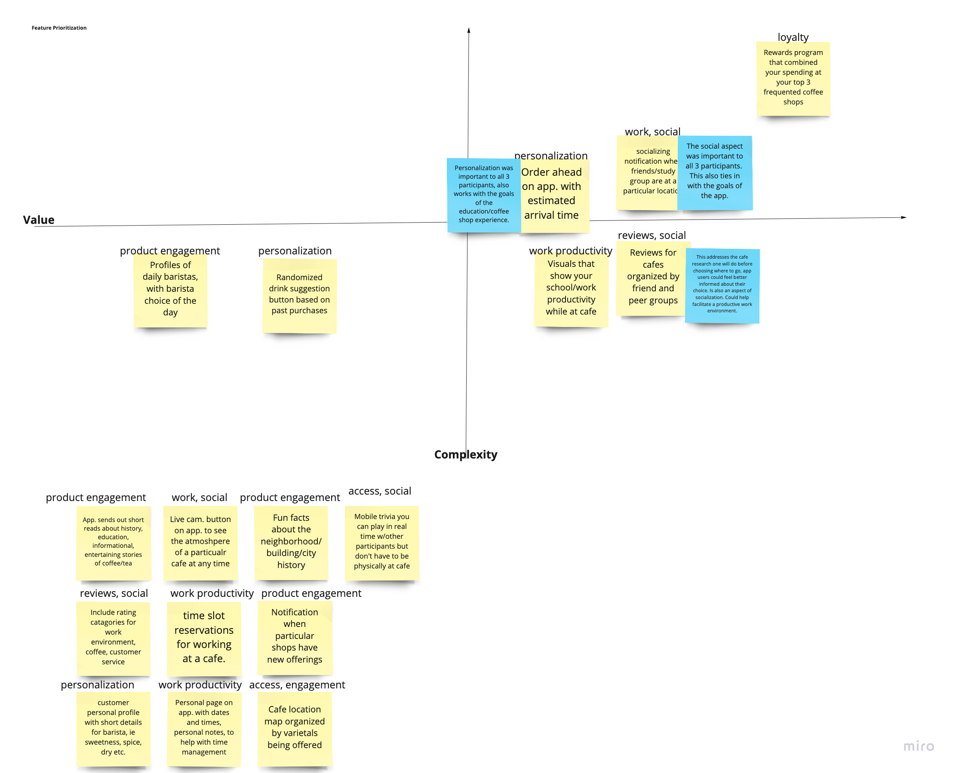
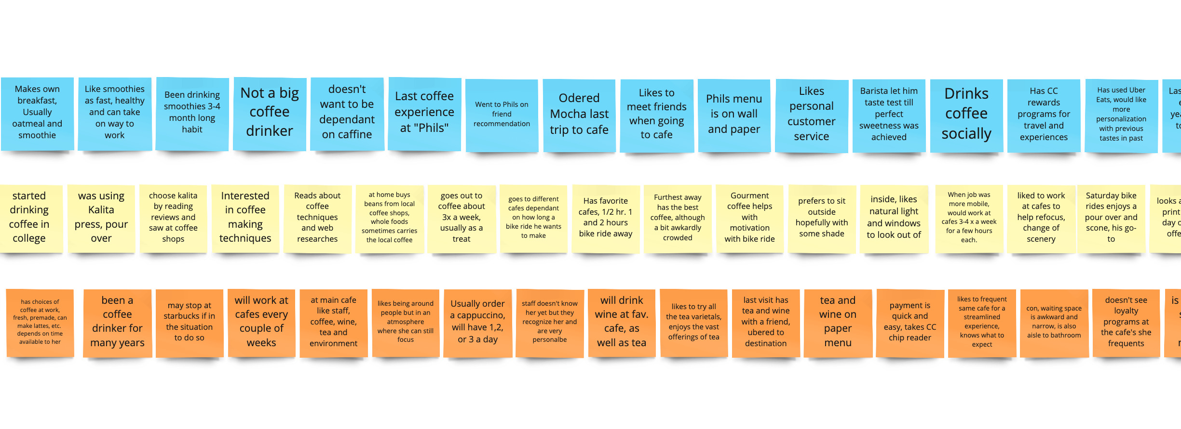
Discovery:
Research & Analysis
For this project I was given access to three interviewees for the Coffeeshop/Education App. Data was collected, interview notes shorted, organized into themes and opportunities, feature ideation, and then organized into a feature prioritizing model using the Value-Cost grid to prioritize features. Miro was used to visually organize data.

Slide 4
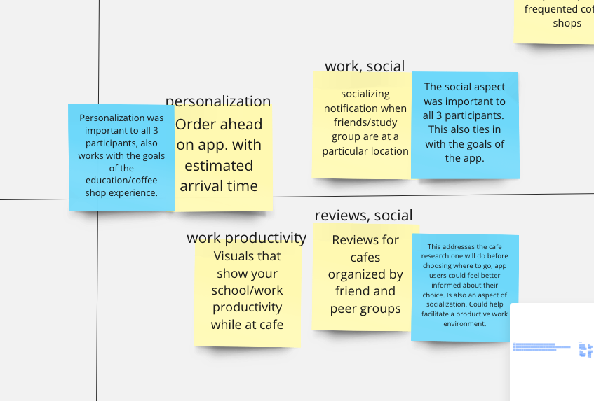
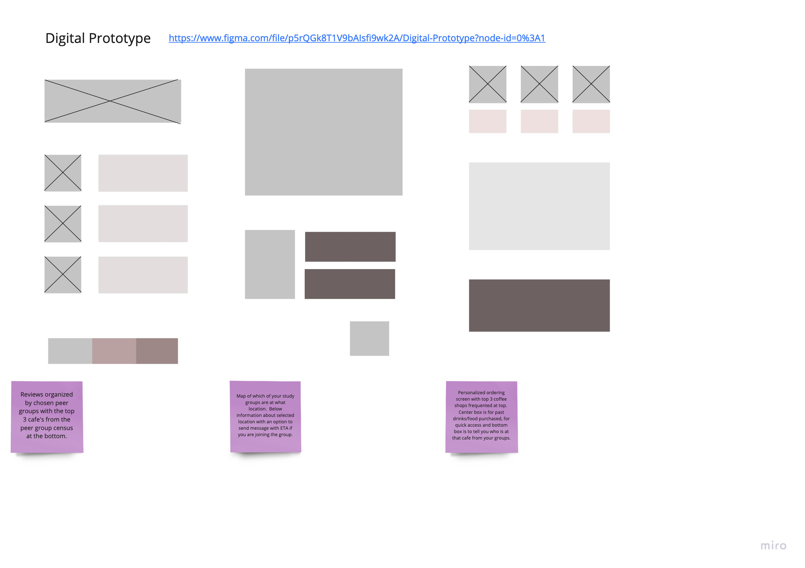
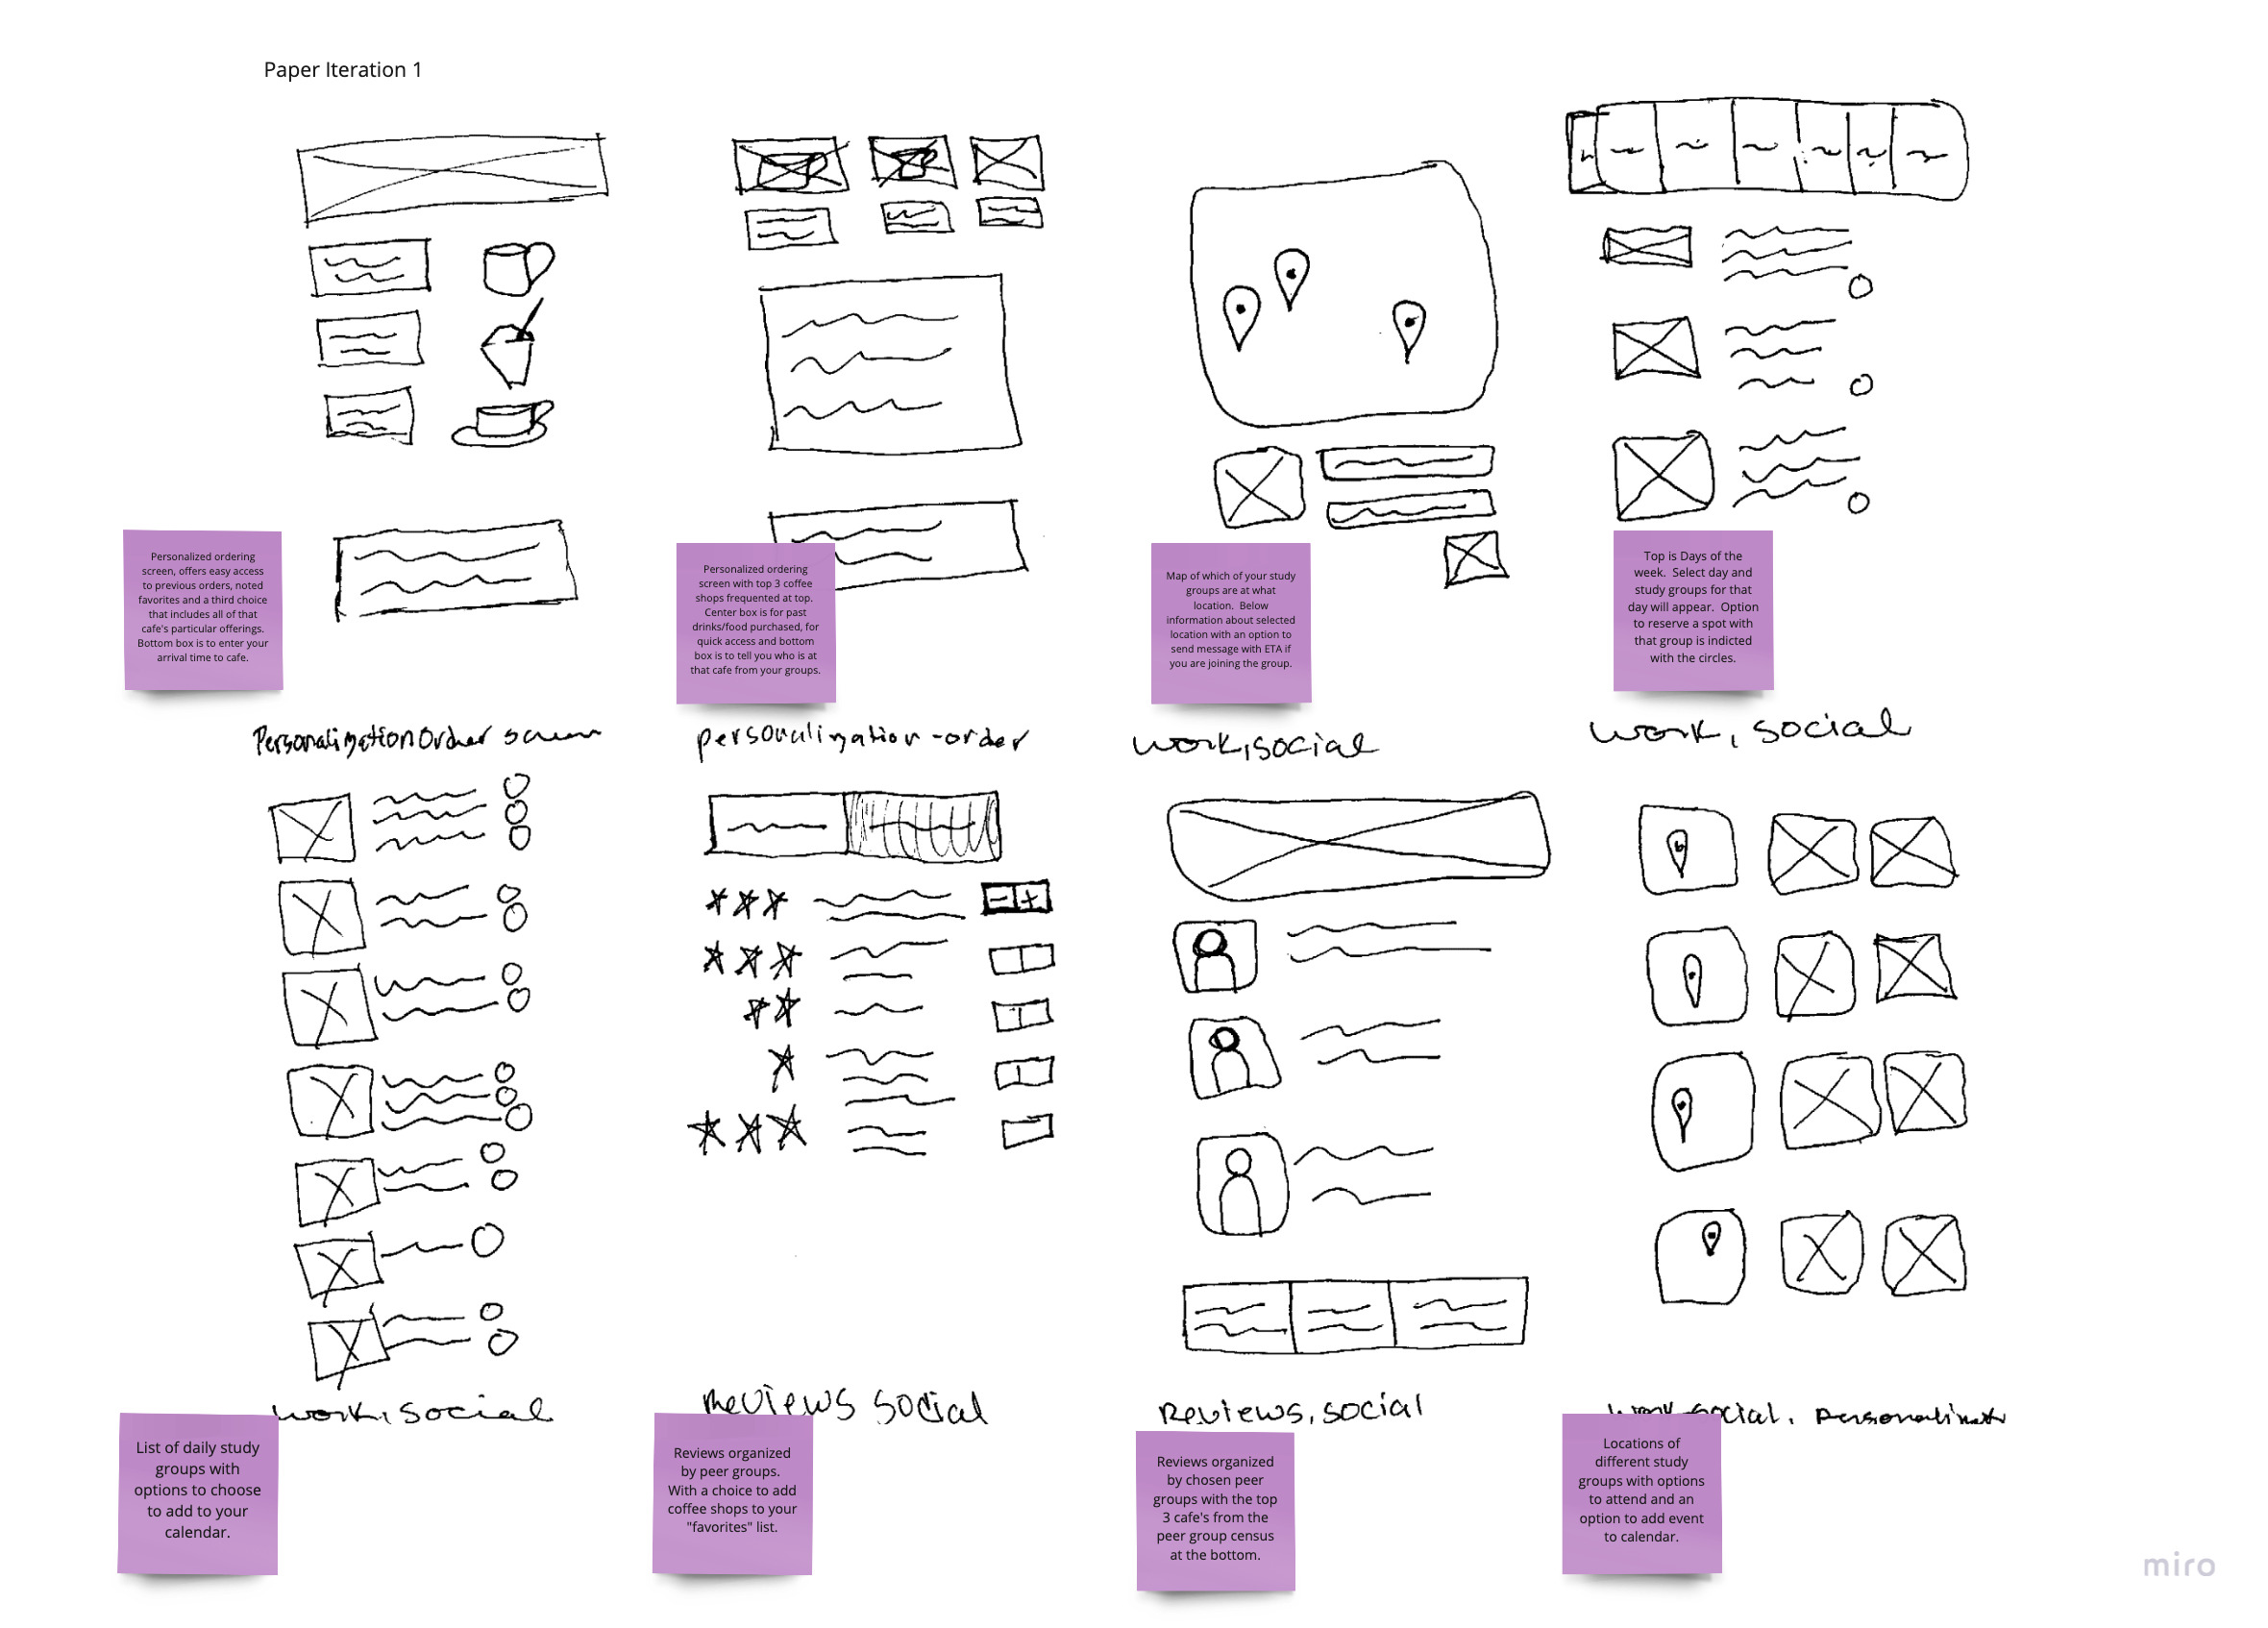
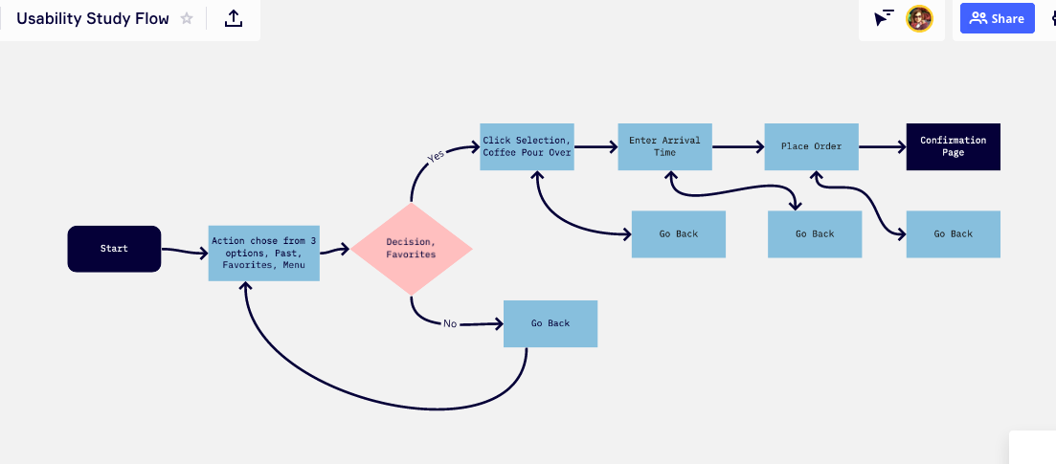
Discovery: Lo-fi design sprint
I created multiple iterations of paper sketches using the crazy-8’s method.
After Research Synthesis I chose to work on the personalization aspect of the app. This category of user needs fell with in the attainable and the lower cost area of the Value vs Complexity quadrant.
After Paper Ideation I created Lo-fi wireframes and a usability flow in order to better understand the steps needed for user to order a personalized drink from their “favorites”.

Slide 5
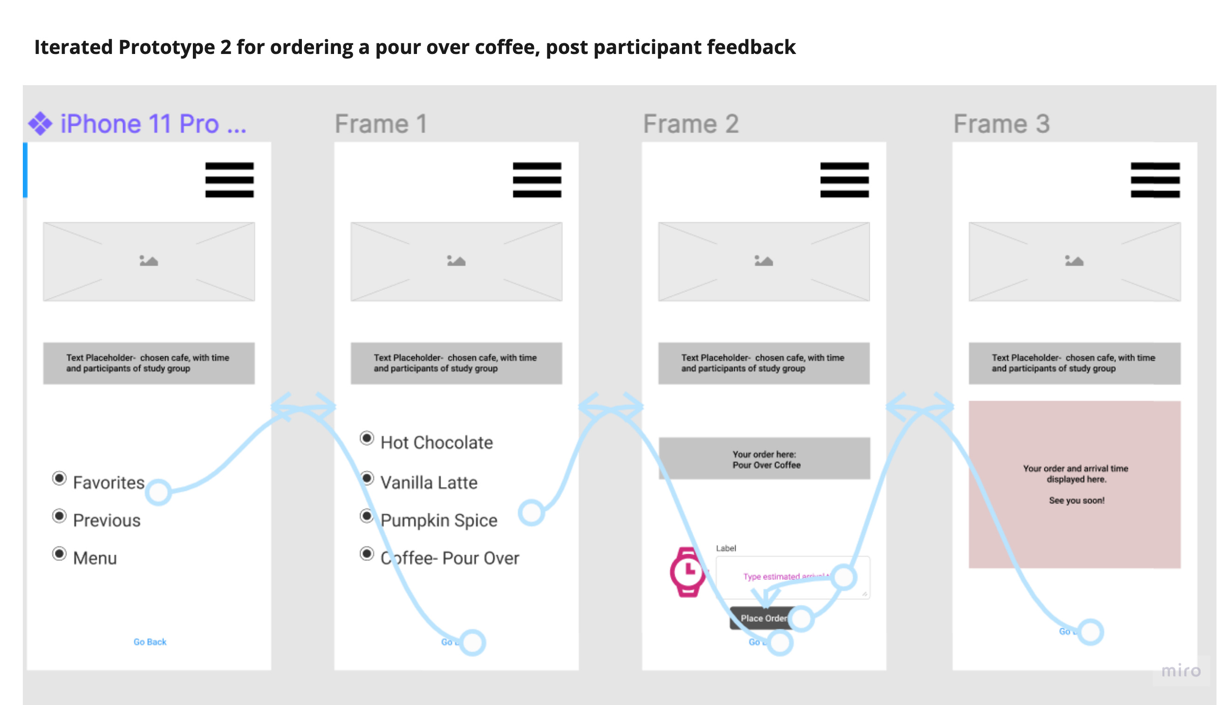
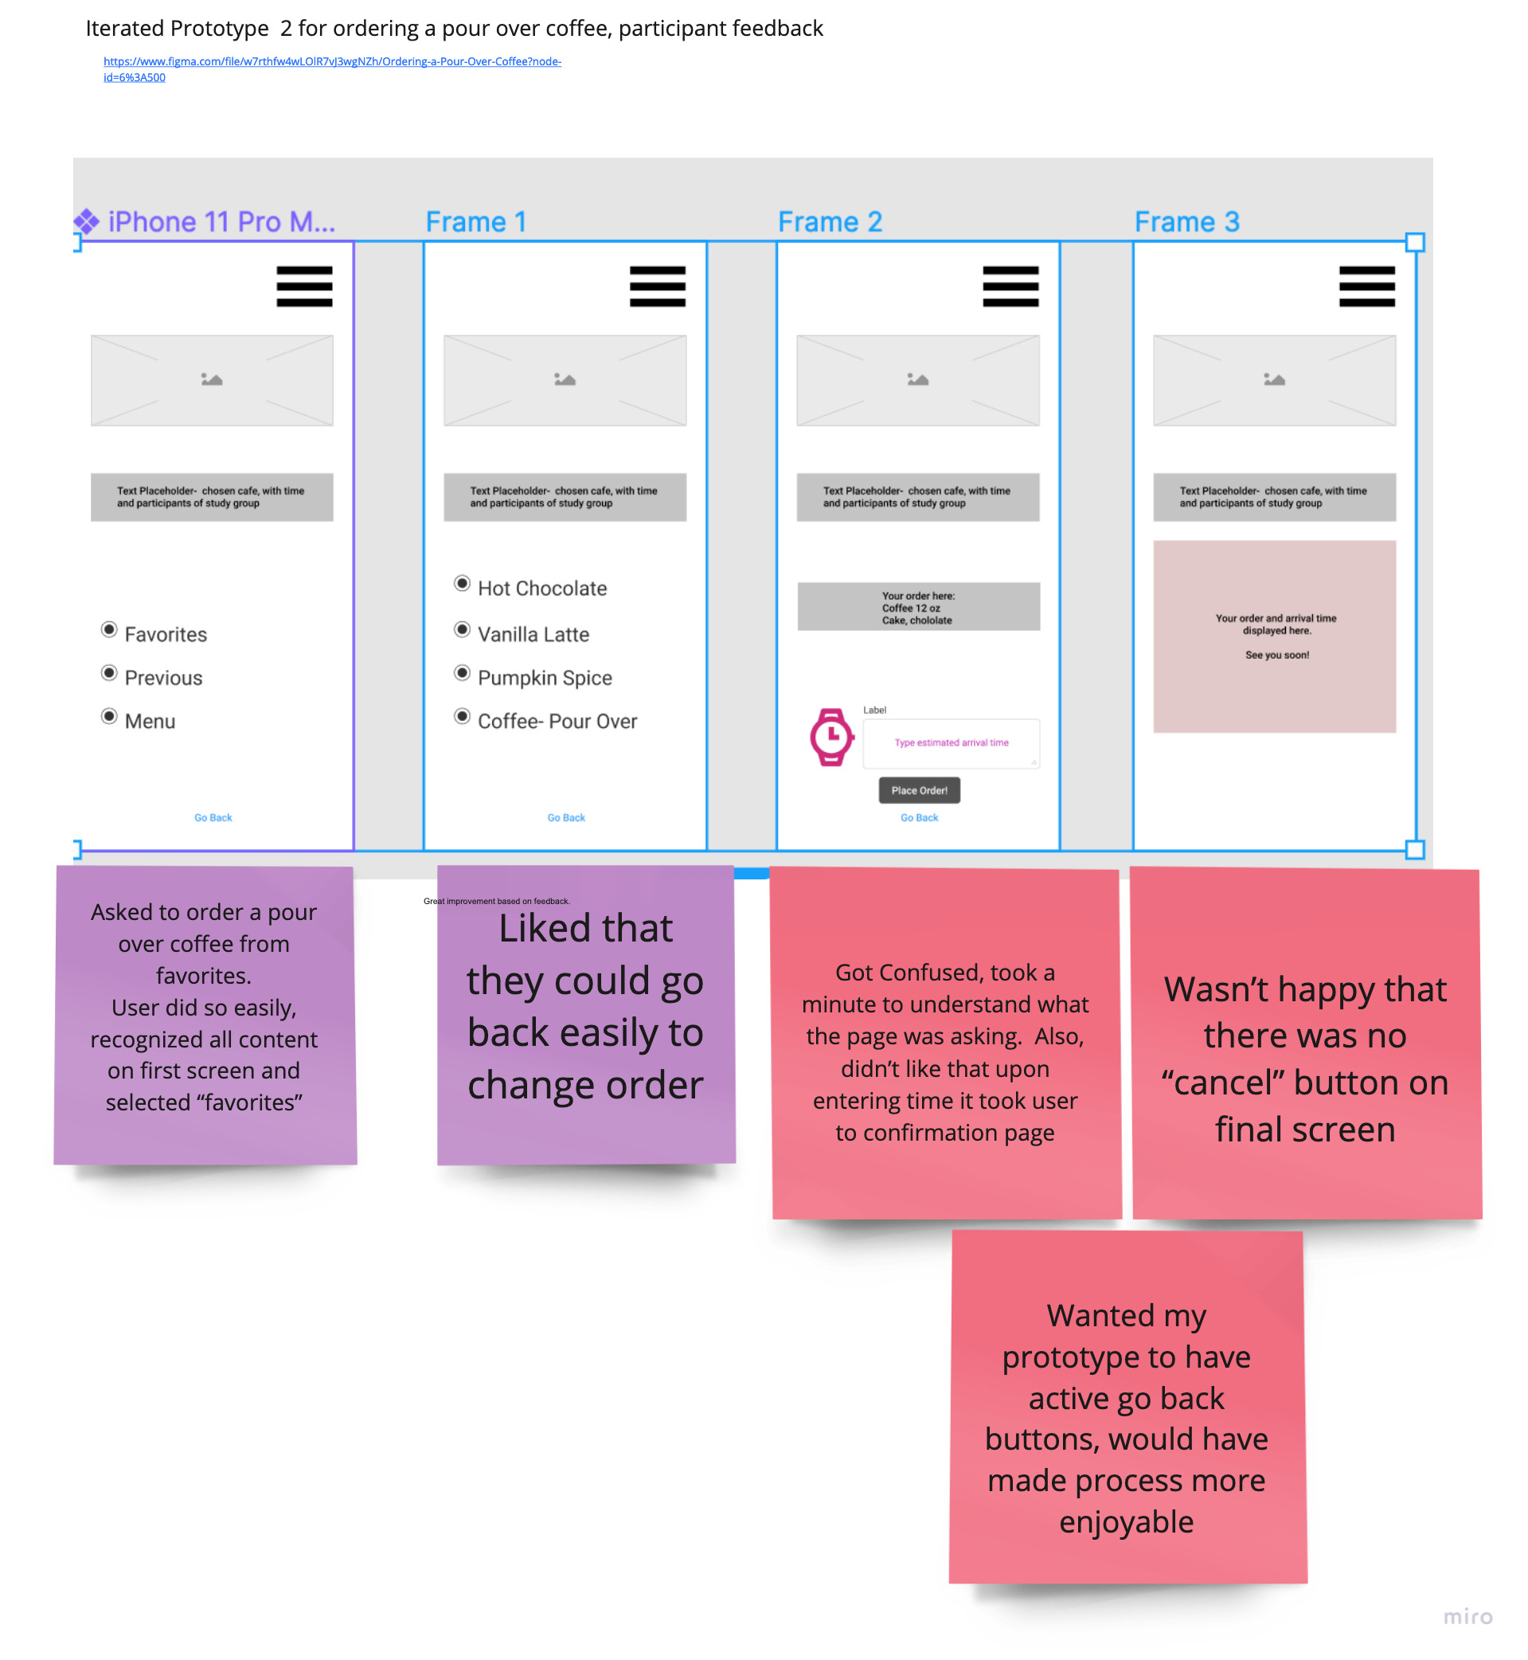
Develop: Lo fi Prototyping
Lo-fi iterations developed in Figma.
Images are the click through lo-fi prototypes after some simple user testing.
User testing was conducted on Figma’s prototype share feature.
Data collected, synthesized, leading to next iteration.

Slide 6
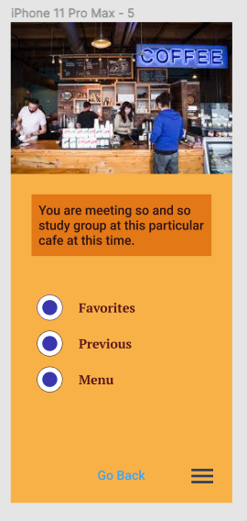
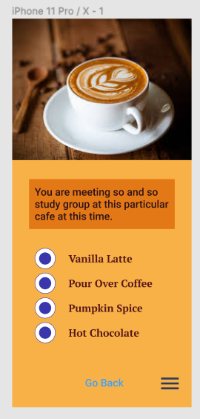
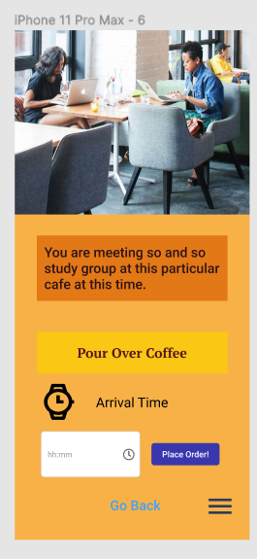
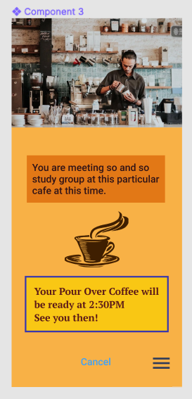
Develop: Hi-fi Prototyping
For clickable prototype in Figma:
https://www.figma.com/proto/w7rthfw4wLOlR7vJ3wgNZh/Ordering-a-Pour-Over-Coffee-from-Favorites?node-id=148%3A305&scaling=scale-down

Slide 7
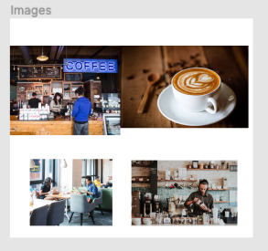
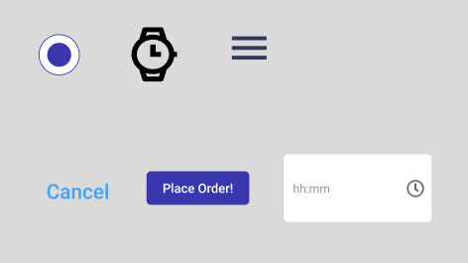
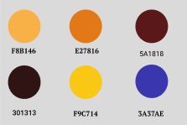
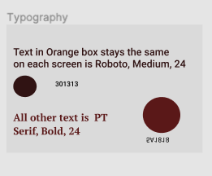
Develop: Style Guide
For the aesthetic of the project I worked on designing the product to be cohesive, assessible, and delightful.

Slide 8
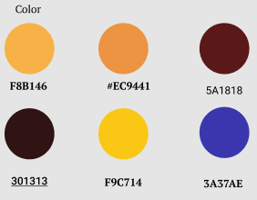
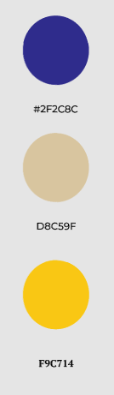
Test: accessibility
Accessibility is an area of UX/UI I am very interested in.
For the Coffeeshop/Education App. the prototype was run through WAVE.
Buttons were spaced out a bit more and extraneous text was taken out.
Changed a few shapes for a cleaner look.
It did not pass the color contrast for readability. I was able to change the colors to a passing score without too much change to the prototype aesthetically.
Colors were run through WAVE. Both the Yellow and Blue colors changed contrast a bit in order to pass the AA and AAA standard.

Slide 9
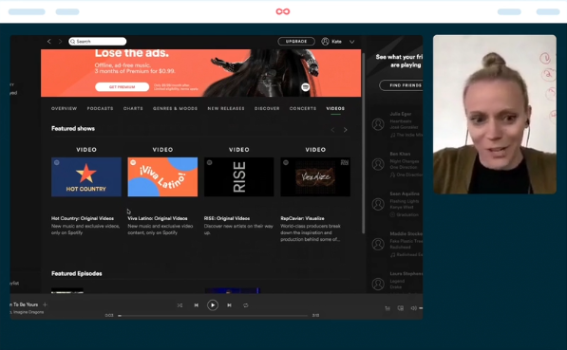
Test: Usability, feedback
Using Lookback, (a user research tool), participants were gathered from the Udacity Peer Chat.
I found it exciting to organize the collected data, finding what flowed and what did not flow, directly from the user's mouth.
I listened to the interviews twice, once to record their words and the second time to observe how their mouse navigated the prototype.
Changes focused on where the majority of the user critique clustered while outliers were considered they did not have great influence on the iteration process.

Slide 10
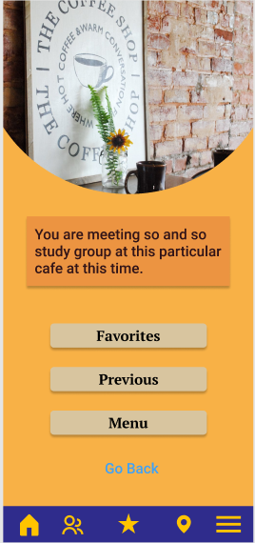
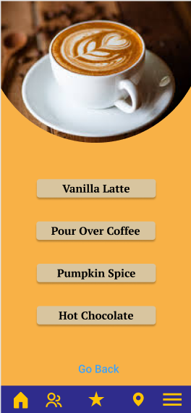
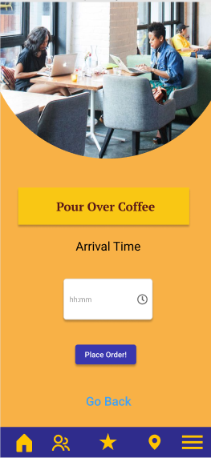
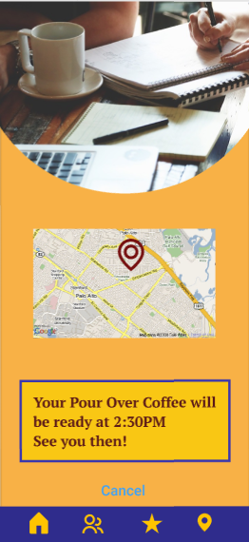
Design: Iteration
Above screens are the iteration sent to Lookback and the second is the iteration based on Lookback feedback.
I will work on decreasing time on completing the task. With most all users (70%) in test wanting to click on the text box of study group details. I wish to improve upon this KPI.
I decided to take out text box and vintage looking graphic and replace with a map feature. This way I can draw upon users experience of map actions and keep users from wasting time trying to click an in-actionable item.

Slide 11
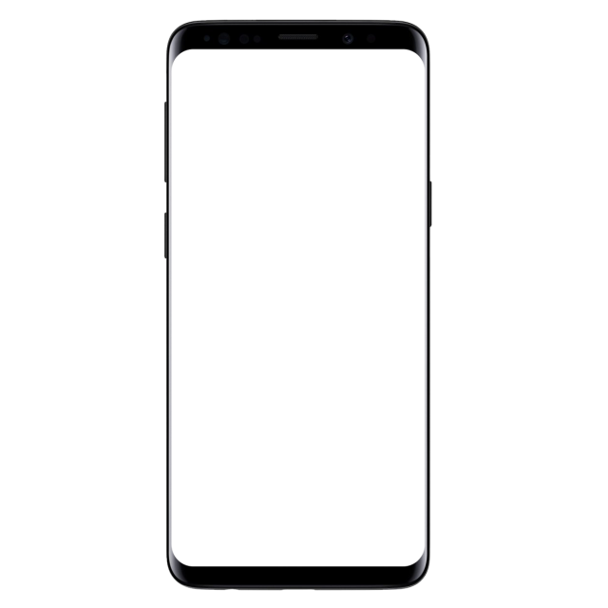
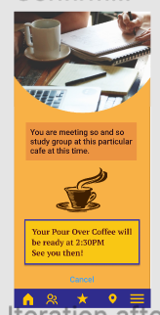
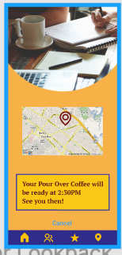
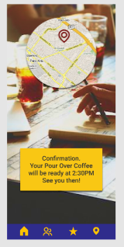
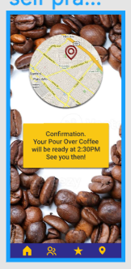
Solution & Impact Overview
While working on the final iteration for class I started to understand why small changes were important to the design process. For example, what seemed like a straightforward change, to move and/or change the sandwich menu icon. There are many possible iterations for a single change! I enjoyed making the prototypes and exploring different designs for the Coffeeshop/Education app.

Slide 12
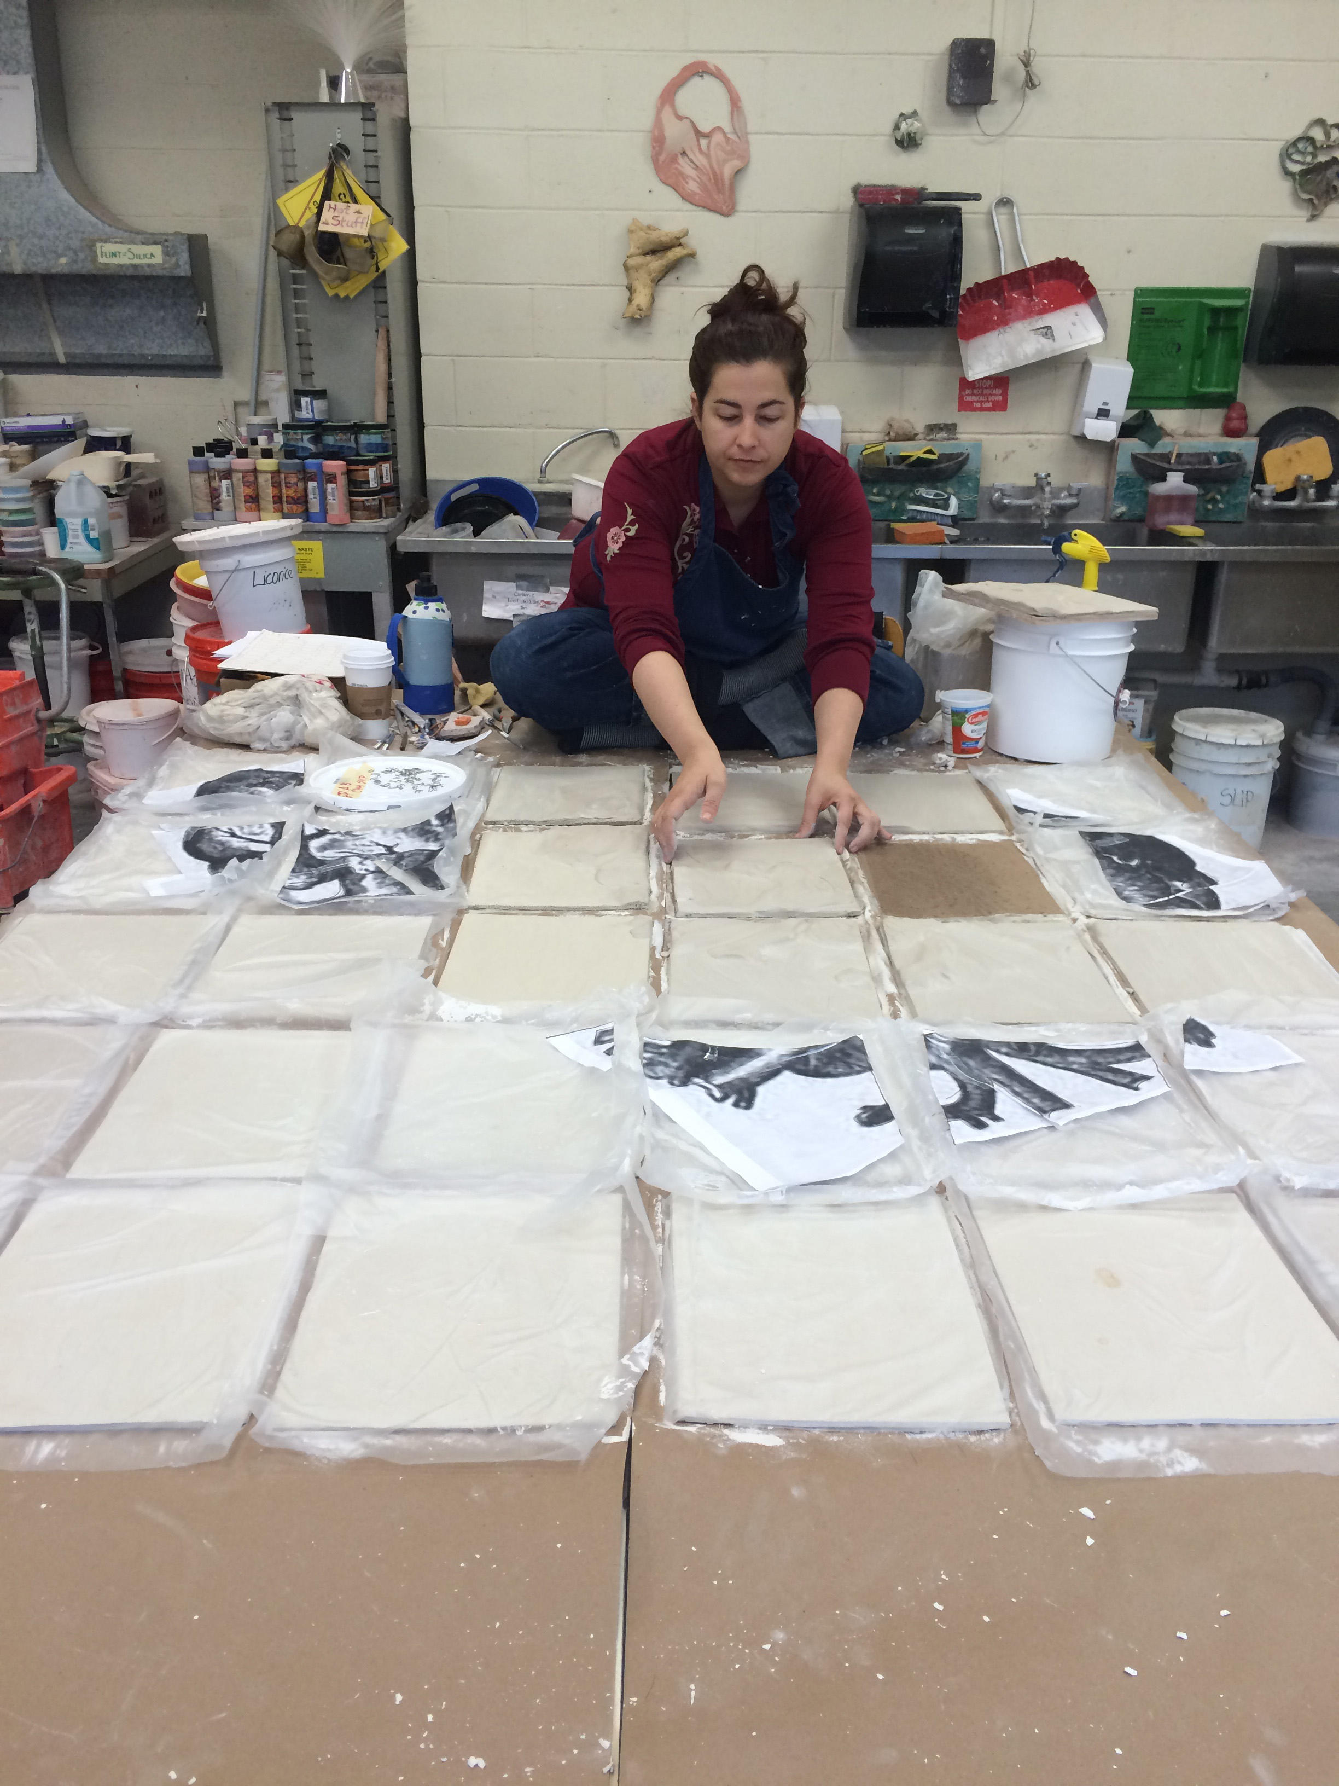
About Me
I am a fresh UX designer ready to jump in whole heartedly. A visual artist by practice with skills in 3-d work, 2-d work and digital arts. I think of my art practice as visual experiences to present to an audience. I hold an MFA in Visual Art and most recently a Nanodegree in UX Design. With UX design I see every opportunity as a moment to engage with users and create lovely, and efficient products.

